Slide 1

Python Intro
Installing Python, Data Types and Variables, Expressions, Loops
SoftUni Team
Technical Trainers
Software University
http://softuni.bg

Slide 2


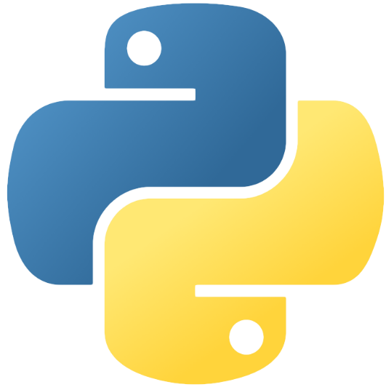
Table of Contents
Python Setup
Console I/O
Variables and Data Types
Expressions & Loops

Slide 3
Questions
sli.do #python-fund

Slide 4

Python Setup
Installing Python and PyCharm

Slide 5
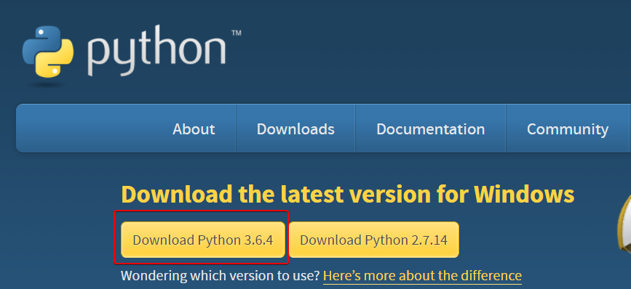
Installing Python
To install Python, we need to go to the python website and download it:
Use version 3.6.4 (or the latest on the site)
https://www.python.org/downloads/

Slide 6
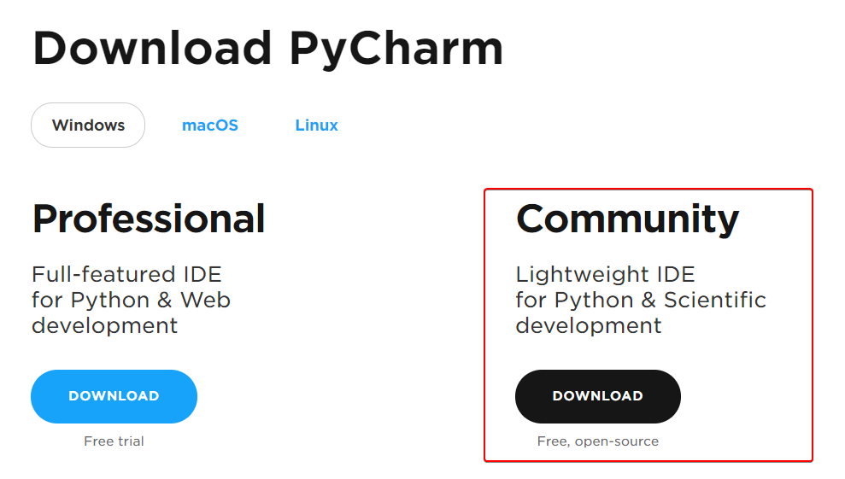
Python IDE - PyCharm
To program in Python, an IDE is recommended
Integrated Development Environment (IDE)
https://www.jetbrains.com/pycharm/download
Community edition is free

Slide 7
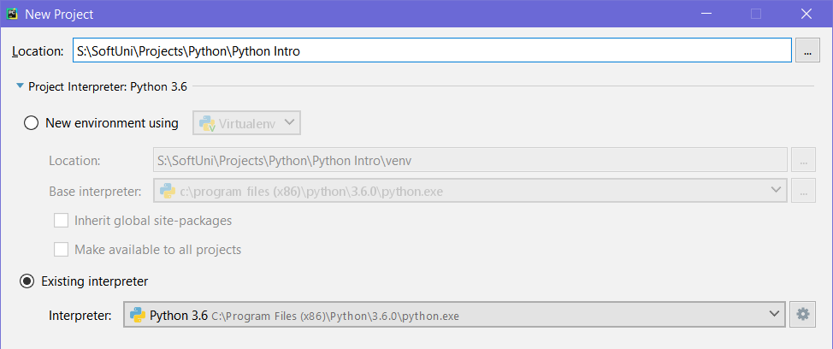
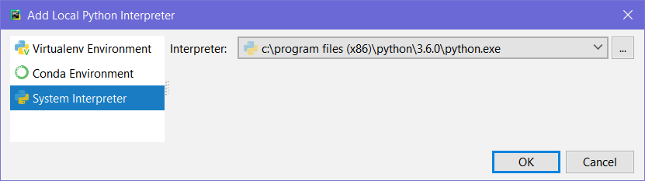
Creating a Console App
Open PyCharm
Create New Project
Set up the Interpreter
Use “Existing Interpreter”
Point it to the python executable

Slide 8
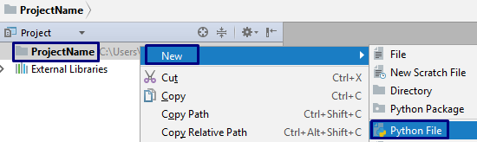
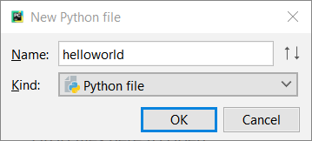
Simple Console App: Hello World
Create a new Python File in the root directory
Write
No semicolons or braces needed!
Run it with either
[Right Click] ➔ [Run 'helloworld']
[Ctrl+Shift+F10]
print('Hello World!')

Slide 9
Variables and Data Types
Definition, Usage, Data Type Conversion

Slide 10

Variables in Python
We can use variables to store data in Python, just like other languages
Declaring a variable:
Types are not declared to the left of the variable
Variable value
Variable name
age = 23
salary = 1600.34
name = 'pesho'
int age = 23

Slide 11
Data Types in Python
Python has very few but robust data types
int – integer (whole) numbers
float – floating point numbers
bool – boolean logical value (True/False)
age = 6
pi = 3.14159265
isAlive = False

Slide 12
Data Types in Python (2)
str – string (character sequence)
Unlike other languages, Python doesn’t use a dedicated char type
list – represents a list of items (of arbitrary types)
Python doesn’t have arrays, every list is mutable
None – equivalent to null in other languages (no value)
name = 'Ivan Ivanov'
primes = [2, 3, 5, 7, 11]
toBeSetLater = None

Slide 13
Data Type Conversion
In Python, we can convert one type to another:
Checking a variable’s type using type():
Example: Converting numeric input from the console:
num = int('10')
realNumAsStr = '2.36'
realNum = float(realNumAsStr)
name = 'Bob'
print(type(name)) # <class 'str'>
name = 3.66
print(type(name)) # <class 'float'>
age = int(input())

Slide 14

Console I/O
Reading and Writing to the Console

Slide 15
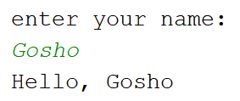
Reading from the Console
Input can be read from the console, using input()
Can be saved into variables (as a string):
print('enter your name:')
name = input()
print('Hello, ' + name)

Slide 16
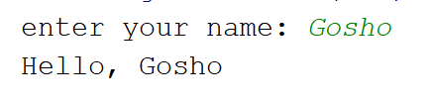
Reading Input on the Same Line
The input() function can print a prompt to the console:
Using print() with an end parameter has the same result:
name = input('enter your name: ')
print('Hello, ' + name)
No new line
print('enter your name: ', end='')
name = input()
print('Hello, ' + name)

Slide 17
String Formatting
In Python, strings can be formatted with placeholders:
Different ways to format a string:
species = 'dog'
age = 2
info1 = 'This %s is %d years old.' % (species, age)
info2 = 'This {} is {} years old.'.format(species, age)
info3 = f'This {species} is {age} years old.'
print(info1, info2, info3, sep='\n')
String formatting
format function
Interpolation

Slide 18
String Formatting (2)
In Python, strings can be formatted with placeholders:
Different ways to format a number:
pi = 3.141592653589793238462643383279
info1 = '{}'.format(pi) # 3.141592653589793
info2 = '{:.3f}'.format(pi) # 3.142
print(info1)
print(info2)
Default format: up to 15th decimal point
Format to the 3rd decimal point

Slide 19
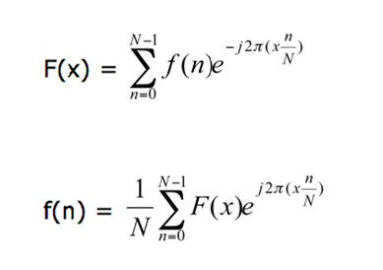
Expressions and Loops
Converting Data Types, Loops

Slide 20
Operators in Python
Operators work the same as other programming languages
Uncommon operators:
** - exponentiation operator
// - integer division
a = 27
i = a / 4 # 6.75
f = a // 4 # 6
r = a % 4 # 3
error = a / 0 # Raises ZeroDivisionError

Slide 21
If Statements in Python
Syntax for if statements:
age = int(input())
ageRange = None
if age < 10:
ageRange = 'child'
elif age < 18:
ageRange = 'teenager'
else:
ageRange = 'adult'
print(f'Your age range is {ageRange}.')

Slide 22
For Loops in Python
Usually use the range([start], end, [step]) function:
Note: range() is exclusive - range(0, 5) is equivalent to [0, 5)
print('Numbers from 0 to 4:')
for i in range(5):
print(i)
# 0, 1, 2, 3, 4
print('Numbers from 5 to 20 by threes:')
for i in range(5, 20, 3):
print(i)
# 5, 8, 11, 14, 17
start and step arguments are optional

Slide 23
Reverse For Loops in Python
The range() function can also produce a descending range:
We can also reverse the range with the reversed() function:
print('Numbers from 9 to 0:')
for i in range(9, -1, -1):
print(i)
# 10 9 8 7 6 5 4 3 2 1
Negative step
print('Numbers from 9 to 0:')
for i in reversed(range(0, 10)):
print(i)
# 10 9 8 7 6 5 4 3 2 1

Slide 24
While Loops in Python
The while construct works for creating a while loop:
Use break and continue to end the loop or skip an iteration:
i = 1
while i < 10:
print(i)
i += 1
i = 0
while True:
i += 1
if i % 2 == 1:
continue # don't print even numbers
if i > 20:
break
print(i)

Slide 25
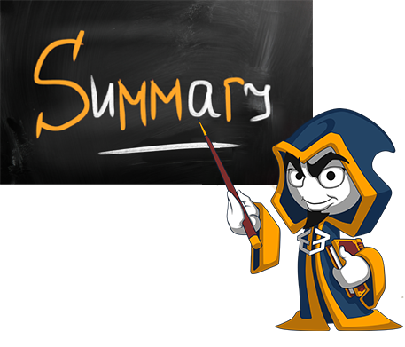
Summary
Python has few but very robust data types
We can read input, using input()
We can print to the console with print()
Formatting strings in Python is easy
Using the range() function for efficient loops
'{:.2f}'.format(3.1415)
f'{3.1415:.2f}'

Slide 27











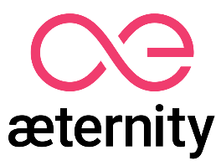

SoftUni Diamond Partners

Slide 28





SoftUni Organizational Partners

Slide 29

License
This course (slides, examples, demos, videos, homework, etc.) is licensed under the "Creative Commons Attribution-NonCommercial-ShareAlike 4.0 International" license
Attribution: this work may contain portions from
"Databases" course by Telerik Academy under CC-BY-NC-SA license

Slide 30
Trainings @ Software University (SoftUni)
Software University – High-Quality Education, Profession and Job for Software Developers
softuni.bg
Software University Foundation
http://softuni.foundation/
Software University @ Facebook
facebook.com/SoftwareUniversity
Software University Forums
forum.softuni.bg

